Slide 1
Introduction to Programming

Slide 2








About Me
Poo Kuan Hoong, http://www.linkedin.com/in/kuanhoong
Principal Data Scientist
Senior Lecturer
Chairperson Data Science Institute
Principal ML Engineer
Senior Data Scientist
Founder R User Group & TensorFlow User Group
Speaker/Trainer
Senior Manager Data Science

Slide 3

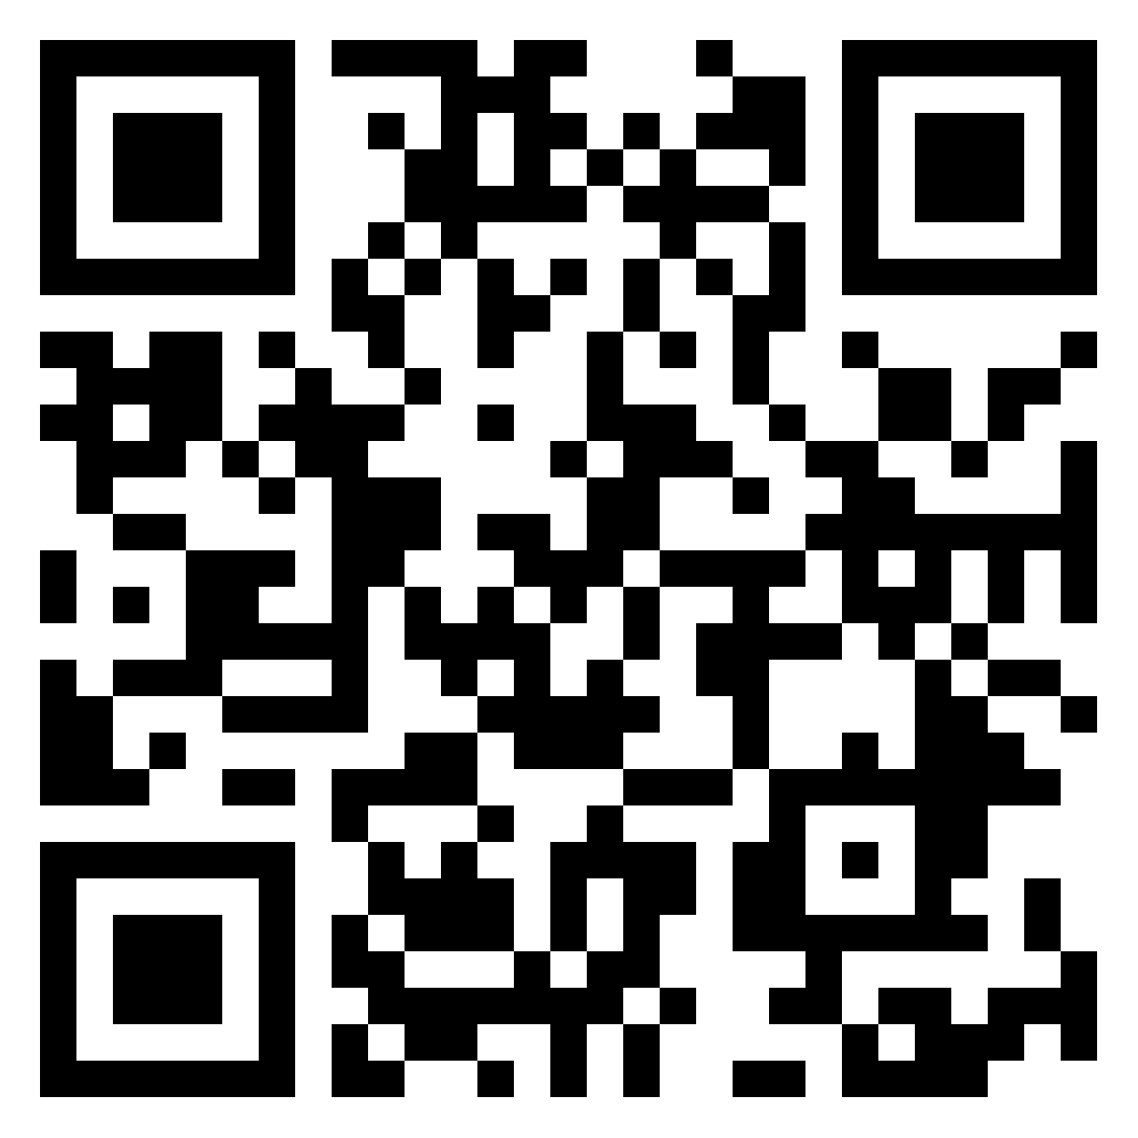
How about you?
https://bit.ly/jds-ip

Slide 4
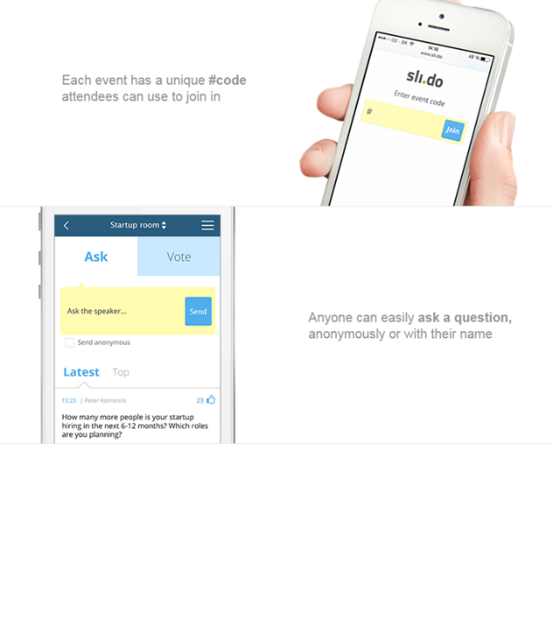
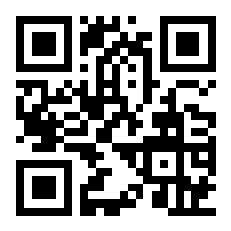
Questions?
www.sli.do code: #JDS-IP

Slide 5
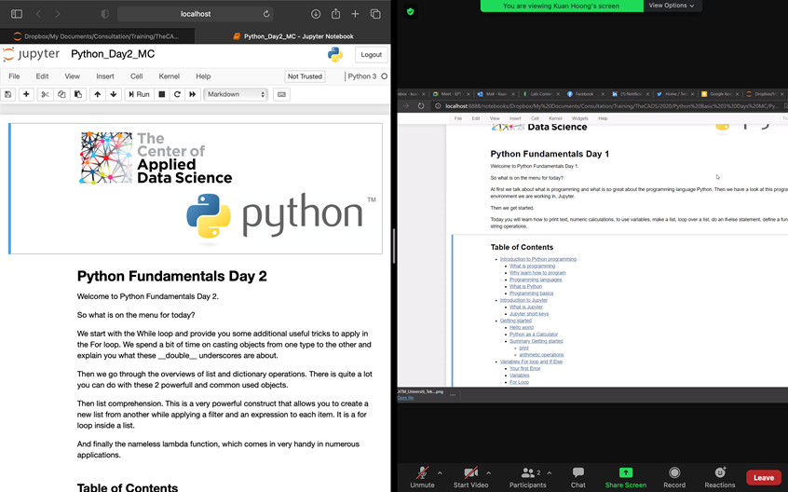
Effective Online Learning
Split screen

Slide 6

Effective Online Learning
Multi screen

Slide 7

Effective Online Learning
Get organized
Be an active participant
Set up your workspace
Figure out how you learn best
Have an open mind
Ask questions

Slide 8
Course Content
A Tour of Computer Systems
Introduction to Algorithms
Basic Concepts (Python)
Control Structures (Python)
Exercises (Python)

Slide 9
A Tour of Computer Systems

Slide 10
What does Computer mean?
A computer is a machine or device that performs processes, calculations and operations based on instructions provided by a software. It is designed to execute applications and provides a variety of solutions by combining integrated hardware and software components.
A computer has two primary categories:
Hardware: Physical structure that houses a computer's processor, memory, storage, communication ports and peripheral devices
Software: Includes operating system (OS) and software applications
Notes:
Computer system
Perform process
Calculations
Operations
Based on instructions from software

Slide 11
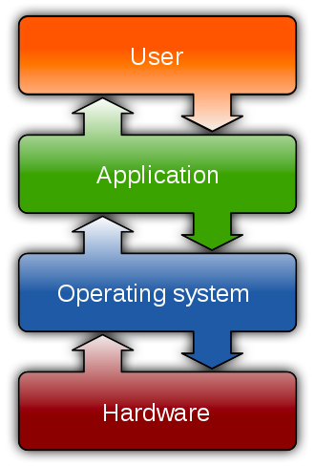
Notes:
OS
-software that manage hardware and software resources

Slide 12
Binary Number System
A computer can understand only the “on” and “off” state of a switch. These two states are represented by 1 and 0.
The combination of 1 and 0 form binary numbers. These numbers represent various data.
As two digits are used to represent numbers, it is called a binary or base 2 number system.

Slide 13
‌Binary Number System
Converting Binary to Decimal
0 | 1 | 0 | 1 | 0 | 1 | 1 | 0
128 | 64 | 32 | 16 | 8 | 4 | 2 | 1
2⁷ | 2⁶ | 2⁵ | 2⁴ | 2³ | 2² | 2¹ | 2⁰
0x128 | 1x64 | 0x32 | 1x16 | 0x8 | 1x4 | 1x2 | 1x0
64 + 16 + 4 + 2 = 86
Notes:
Before everything talk about bits, bytes,…

Slide 14
‌Binary Number System
Converting Decimal to Binary
‌Binary Number System
2 | 25
2 | 12 | 1 | 🡨 | 1st Remainder
2 | 6 | 0 | 🡨 | 2nd Remainder
2 | 3 | 0 | 🡨 | 3rd Remainder
2 | 1 | 1 | 🡨 | 4th Remainder
 | 0 | 1 | 🡨 | 5th Remainder
 |  | Read Upwards
 | Binary Number = 11001

Slide 15

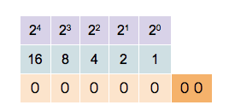
‌Binary Number System

Slide 16
‌Computer Hardware
To understand what happens to a program when we run it, we need to understand the hardware organization of a typical system, which is shown in the next slide.

Slide 17
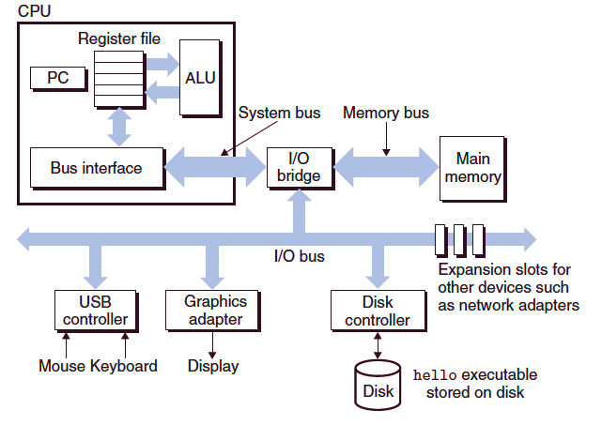

Slide 18
Buses
Running throughout the system is a collection of electrical conduits called buses that carry bytes of information back and forth between the components.
Buses are typically designed to transfer fixed-sized chunks of bytes known as words. The number of bytes in a word (the word size) is a fundamental system parameter that varies across systems.
Most machines today have word sizes of either 4 bytes (32 bits) or 8 bytes (64 bits).

Slide 19
I/O Devices
Input/output (I/O) devices are the system’s connection to the external world.
Each I/O device is connected to the I/O bus by either a controller or an adapter.
Each I/O device is connected to the I/O bus by either a controller or an adapter.
The distinction between the two is mainly one of packaging. Controllers are chipsets in the device itself or on the system’s main printed circuit board (often called the motherboard). An adapter is a card that plugs into a slot on the motherboard.

Slide 20
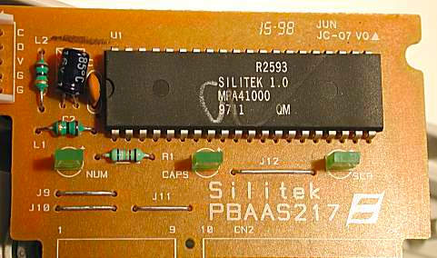
Notes:
Keyboard controller

Slide 21
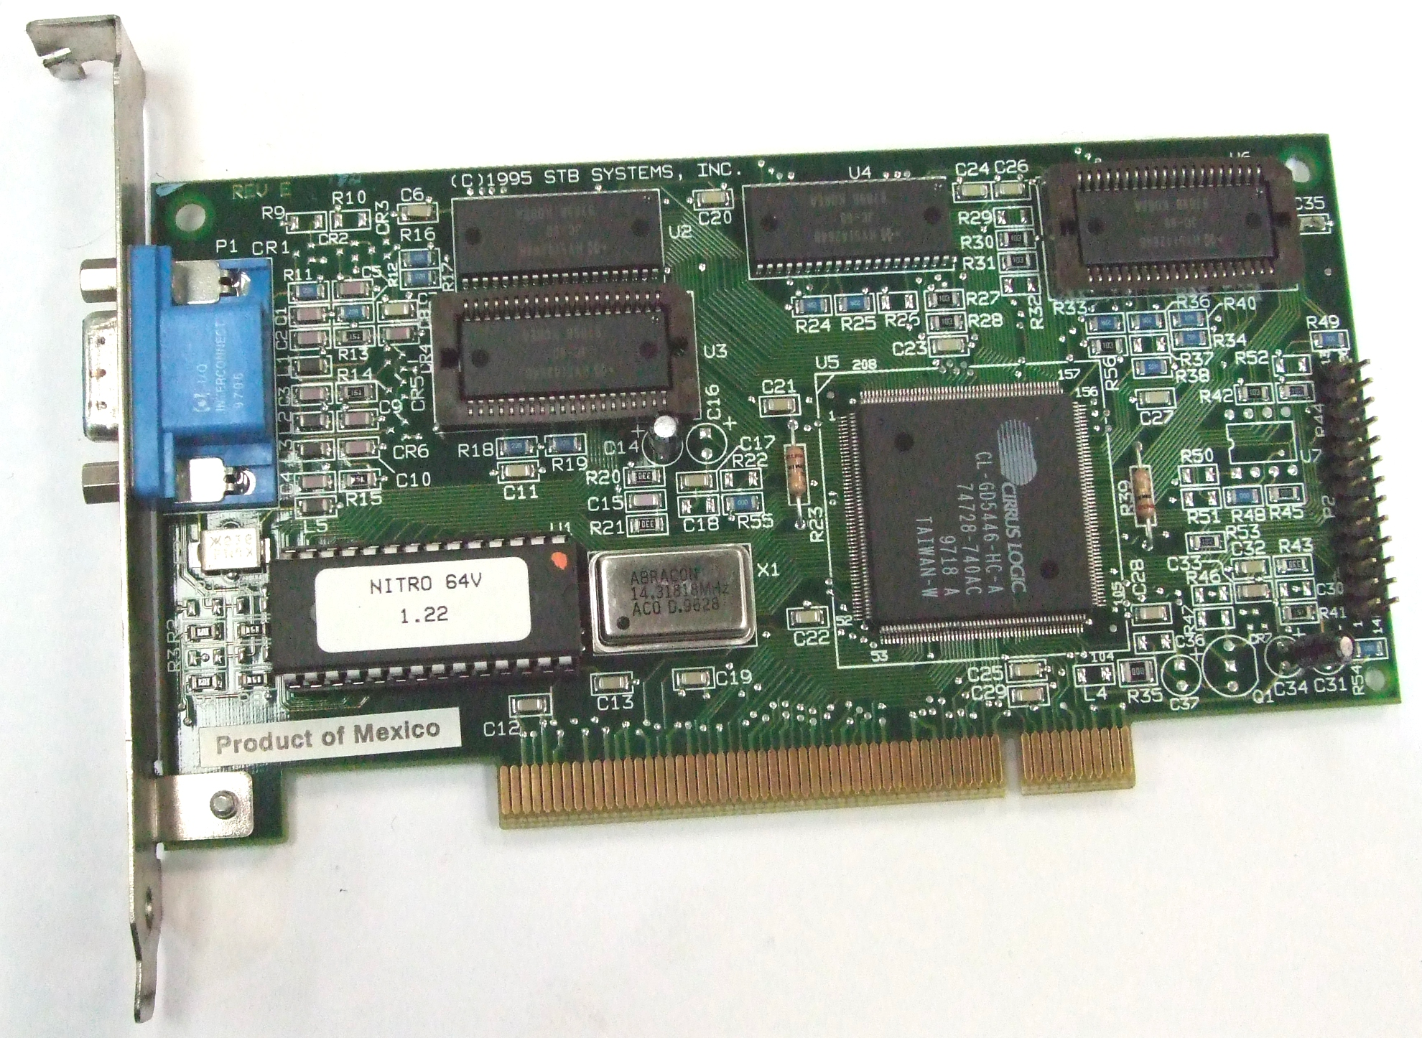

Slide 22
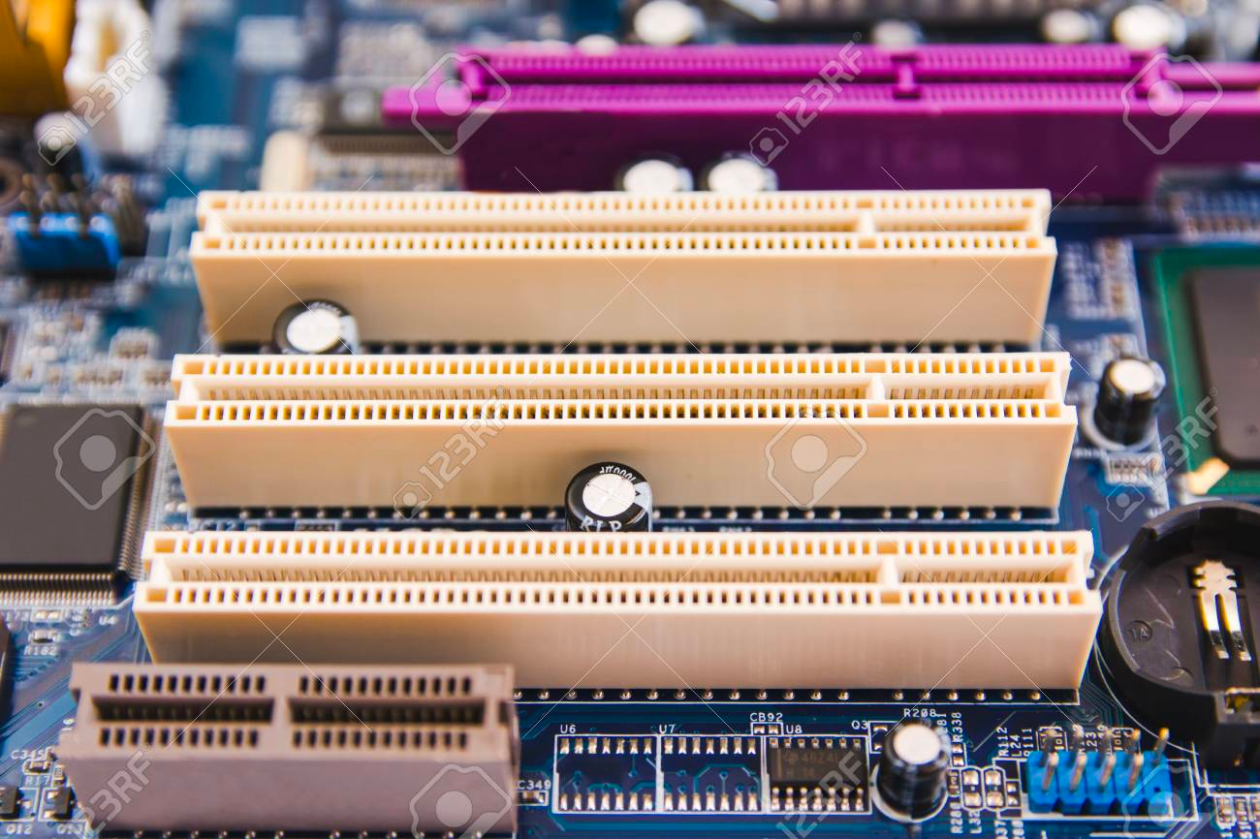

Slide 23
Main Memory
The main memory is a temporary storage device that holds both a program and the data it manipulates while the processor is executing the program.
Physically, the main memory consists of a collection of dynamic random access memory (DRAM) chips.
Logically, memory is organized as a linear array of bytes, each with its unique address (array index) starting at zero.
In general, each of the machine instructions that constitute a program can consist of a variable number of bytes.

Slide 24
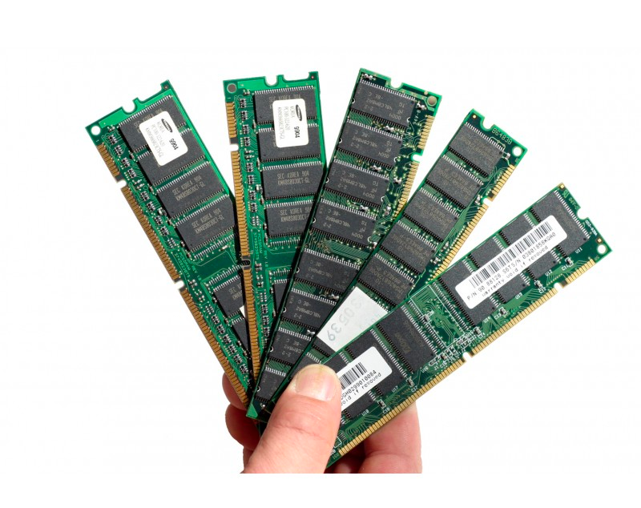

Slide 25
Processor
The central processing unit (CPU), or simply processor, is the engine that interprets (or executes) instructions stored in the main memory.
At its core is a word-sized storage device (or register) called the program counter (PC).
At any point in time, the PC points at (contains the address of) some machine-language instruction in main memory.

Slide 26
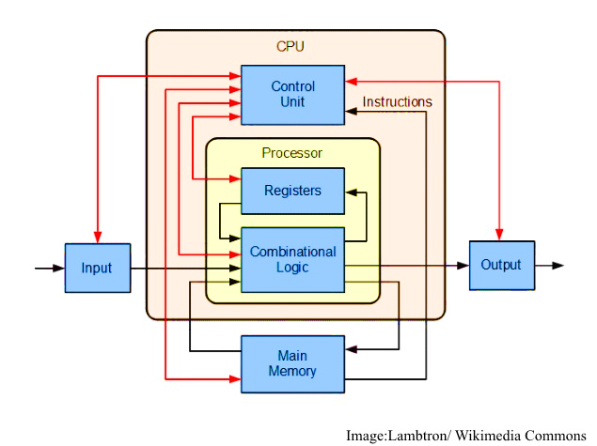

Slide 27
What is an Operating System?
An operating system (OS) is system software that manages computer hardware and software resources and provides common services for computer programs.

Slide 28
‌Computer Software
Computer software, also called software or application, is a set of instructions and its documentations that tells a computer what to do or how to perform a task.
Software includes all different software programs on a computer, such as applications and the operating system.
The next chapter details the set of instructions in a computer software, also known as algorithms.

Slide 29

Quiz 1
https://bit.ly/jds-ip-q1

Slide 30
Introduction to Algorithms

Slide 31
What is an Algorithm?
Describing Algorithms with Flowcharts
Introduction to Programming

Slide 32
What is an Algorithm? Definition and Structure
Definition
A set of step-by-step instructions to solve a problem.
Requirements
Can be described in a formal language
Consist of a finite number of steps
Operate on zero or more inputs
Result in an output
Individual steps are sufficiently basic and can be executed in finite time
Notes:
Can be described in a formal language
This means who- or whatever is executing the algorithm needs to be able to translate the descriptive language into primitive actions. For example, a toddler learning to tie their shoelaces should be able to translate instructions to hand and finger movements.
Consist of a finite number of steps
This means that an algorithm description must require a finite number of steps. The algorithm execution itself may very well be infinite, e.g. an algorithm that continuously computes prime numbers.
Operate on zero or more inputs
Several varieties of algorithms exist with regard to the inputs:
Algorithms without inputs, e.g. cooking recipes.
Algorithms with fixed inputs, e.g. an algorithm to compute the sum of the first 10 positive numbers.
Algorithms with user-defined inputs, e.g. an algorithm to compute the sum of the first n positive numbers.
Result in an output
As opposed to inputs, an algorithm must always have an output. If an algorithm has inputs, these should influence the output in a well-defined manner. If outputs do not relate to inputs then the inputs become unnecessary ( → bad algorithm design)
Consist of sufficiently basic and well-defined steps that can be executed with finite resources
Sufficiently basic means that the executing agent must be able to understand each individual step WITHOUT knowing the entire algorithm
Well-defined means that they conform to the formal language of the executing agent, e.g. no dividing by zero

Slide 33
What is an Algorithm? Examples of Algorithms
Calculate the sum of the first 10 positive numbers
Recipe for baking a cake
Recommend products to consumers based on previous transactions

Slide 34
What is an Algorithm? Examples of Algorithms
Exercise 1
Write an algorithm to find the page number of the chapter Little Em’ly of the book David Copperfield by Charles Dickens.
Notes:
Exercise goal: Explore simple, step-by-step instructions with free prose

Slide 35
What is an Algorithm? Examples of Algorithms
Write an algorithm to find the page number of the chapter Little Em’ly of the book David Copperfield by Charles Dickens.
Solution A:
Open book
Flip through pages we see the chapter title Little Em’ly at the top of the page
Write down page number
Solution B:
Open book
Turn to the table of contents
Write down page number of chapter Little Em’ly

Slide 36
What is an Algorithm? Examples of Algorithms
Write an algorithm to find the page number of the chapter Little Em’ly of the book David Copperfield by Charles Dickens.
Solution A:
Open book
Flip through pages we see the chapter title Little Em’ly at the top of the page
Write down page number
Solution B:
Open book
Turn to the table of contents
Write down page number of chapter Little Em’ly
Many different solutions are possible!

Slide 37
What is an Algorithm? Examples of Algorithms
Exercise 2
Write an algorithm that takes two numbers and adds their squares.
Notes:
Exercise goal: Introduce mathematical language into algorithms

Slide 38
What is an Algorithm? Examples of Algorithms
Write an algorithm that takes two numbers and adds their squares.
Solution A:
Input first number
Compute square of first number
Input second number
Compute square of second number
Add the squares of the numbers
Output the sum of the squares
Solution B:
f(x, y) = x² + y²

Slide 39
What is an Algorithm? Examples of Algorithms
Write an algorithm that takes two numbers and adds their squares.
Solution A:
Input first number
Compute square of first number
Input second number
Compute square of second number
Add the squares of the numbers
Output the sum of the squares
Solution B:
f(x, y) = x² + y²

Slide 40
What is an Algorithm?
Describing Algorithms with Flowcharts
Introduction to Programming

Slide 41
Describing Algorithms with Flowcharts What are Flowcharts?
Flowcharts are connected sequences of instructions
Allows for easy visualization of algorithmic logic
Provides a common language for algorithmic logic
Typically go from top to bottom and left to right
Read first number
Compute square
Add numbers
Print sum
Read second number
Compute square
Notes:
What is a Flowchart? A diagram that uses graphic symbols to depict the nature and flow of the steps in a process.
Why Flowcharts:
Visually present the flow of data
Describe required operations
Allow the programmers to pre-plan and map out the flow of a program
Are sometimes required by the customer or the company for documentation

Slide 42
Describing Algorithms with Flowcharts Common Flowchart Symbols
Flowline: Shows the flow of the algorithm
.
Symbols are defined by the International Standards Organization (ISO). More info at https://en.wikipedia.org/wiki/Flowchart#Common_symbols

Slide 43
Describing Algorithms with Flowcharts Common Flowchart Symbols
Flowline: Shows the flow of the algorithm
Input/Output: Data read or produced by the algorithm. Represented by a parallelogram.
.
Symbols are defined by the International Standards Organization (ISO). More info at https://en.wikipedia.org/wiki/Flowchart#Common_symbols

Slide 44
Describing Algorithms with Flowcharts Common Flowchart Symbols
Flowline: Shows the flow of the algorithm
Input/Output: Data read or produced by the algorithm. Represented by a parallelogram.
Process: An action, e.g. addition. Represented by a rectangle
.
Symbols are defined by the International Standards Organization (ISO). More info at https://en.wikipedia.org/wiki/Flowchart#Common_symbols

Slide 45
Describing Algorithms with Flowcharts Common Flowchart Symbols
Flowline: Shows the flow of the algorithm
Input/Output: Data read or produced by the algorithm. Represented by a parallelogram.
Process: An action, e.g. addition. Represented by a rectangle
Decision: A conditional query that determines the path the program will take. Commonly a yes/no question. Represented by a diamond.
.
Symbols are defined by the International Standards Organization (ISO). More info at https://en.wikipedia.org/wiki/Flowchart#Common_symbols

Slide 46
Describing Algorithms with Flowcharts Common Flowchart Symbols
Flowline: Shows the flow of the algorithm
Input/Output: Data read or produced by the algorithm. Represented by a parallelogram.
Process: An action, e.g. addition. Represented by a rectangle
Decision: A conditional query that determines the path the program will take. Commonly a yes/no question. Represented by a diamond.
Terminal: The beginning and end of an algorithm. Represented by a stadium (rectangle with half-circles on either side).
.
Symbols are defined by the International Standards Organization (ISO). More info at https://en.wikipedia.org/wiki/Flowchart#Common_symbols

Slide 47
Describing Algorithms with Flowcharts Common Flowchart Symbols
Flowline: Shows the flow of the algorithm
Input/Output: Data read or produced by the algorithm. Represented by a parallelogram.
Process: An action, e.g. addition. Represented by a rectangle
Decision: A conditional query that determines the path the program will take. Commonly a yes/no question. Represented by a diamond.
Terminal: The beginning and end of an algorithm. Represented by a stadium (rectangle with half-circles on either side).
.
Symbols are defined by the International Standards Organization (ISO). More info at https://en.wikipedia.org/wiki/Flowchart#Common_symbols

Slide 48
Programming Elements Variables
Definition
Variables are symbols that represent underlying, changeable values, e.g.
words: Name = “Alex”
numbers: Age = 50
309
count
310
7
311
2040
sum
2041
28
In computers
Variables reference blocks of memory at which data is stored
2042
Notes:
Cropped content (probably too detailed)
* Many modern programming languages, e.g. Python and R, handle memory allocation automatically 🡪 developers only need to worry about variable names

Slide 49
Programming Elements Conditional Statements
Definition
Conditional statements, also called if-else statements, perform a logical test and direct algorithm flow depending on the output.
Input
Logical Test
Program flow if logical
test evaluates to FALSE
Program flow if logical
test evaluates to TRUE

Slide 50
Programming Elements Conditional Statements
start
Conditional statements can also be used to skip over an action,
e.g. an algorithm that adds 1 to odd inputs but leaves even inputs unchanged.
read X
Is X even?
FALSE
TRUE
X = X + 1
print X
stop

Slide 51
Programming Elements Conditional Statements
Conditional statements require logical operations. Logical operations should result in a Boolean value:
TRUE, i.e. ‘yes’
FALSE, i.e. ‘no’
Programming languages have different rules for how they interpret non-Boolean values
e.g. R and Python interpret 0 as FALSE and any non-zero number as TRUE
Relational Operators (for numerical values)
x == y | Is x equal to y?
x ≠ y (x != y) | Is x not equal to y?
x < y | Is x less than y?
x > y | Is x greater than y?
x ≤ y (x <= y) | Is x less than or equal to y?
x ≥ y (x >= y) | Is x greater than or equal to y?
Notes:
It is absolutely not important that students memorize all of these now

Slide 52
Programming Elements Conditional Statements
Exercise 3
Design an algorithm as a flowchart that takes three numbers as input and prints the largest of them.
Notes:
Exercise goal: Conditional statements (including subsequent/nested if-clauses)

Slide 53
Programming Elements Conditional Statements
Design an algorithm as a flowchart that takes three numbers as input and prints the largest of them.
start
read A, B, C
YES
B>C
NO
A>B
YES
A>C
YES
NO
NO
print B
print C
print A
stop

Slide 54
Programming Elements Loops
Input
Two general types of loops exist:
count-controlled loops, i.e. loops that execute a pre-defined number of times
e.g. a loop that adds the first 10 positive numbers.
dynamically terminated loops, i.e. loops that only terminate once a condition, evaluated within the loop, is met.
e.g. a loop that continues until a user guesses a number
Loop Condition (LC)
LC fulfilled
LC not fulfilled
Loop action
Continue program
Definition
Loops are sequences of instructions that are executed repeatedly.

Slide 55
Programming Elements Loops
Exercise 4
Design an algorithm as a flowchart that adds the squares of the first 10 numbers.
Notes:
Exercise goal: Introduce simple loops

Slide 56
Programming Elements Loops
start
Initialize two variables, placeholders for values.
sum is the running sum of all numbers
count keeps track of how many numbers have already been added to sum
If count is greater than 10, we’ve added the squares of the first 10 numbers to sum (since count started at 1). Output sum and end the algorithm.
If count is not greater than 10, add its square to sum, increase count by 1, and loop back to the conditional statement.
sum = 0
count = 1
count > 10
YES
print sum
NO
increment = count²
stop
sum = sum + increment
count = count + 1

Slide 57
Programming Elements Loops
start
What happens in the loop?
Iteration 1 (sum = 0; count = 1 🡪 stay in loop)
increment = count² = 1² = 1
sum = sum + increment = 0 + 1 = 1
count = count + 1 = 1 + 1 = 2
Iteration 2 (sum = 1; count = 2 🡪 stay in loop)
increment = count² = 2² = 4
sum = sum + increment = 1 + 4 = 5
count = count + 1 = 2 + 1 = 3
…
Iteration 10 (sum = 285; count = 10 🡪 stay in loop)
increment = count² = 10² = 100
sum = sum + increment = 285 + 100 = 385
count = count + 1 = 10 + 1 = 11
Iteration 11 (sum = 385; count = 11 🡪 leave loop!)
print ‘385’
sum = 0
count = 1
count > 10
YES
print sum
NO
increment = count²
stop
sum = sum + increment
count = count + 1
Notes:
SUGGESTED TODO: Change this into an animated slide / sequence of slides (pseudo-animated) and place the number values directly into the flowchart

Slide 58
Programming Elements Loops
Exercise 5
Design an algorithm as a flowchart that lets a user enter ‘N’ numbers and prints out the largest of the numbers. The algorithm should take ‘N’ as an input.
Hint:
start
input N, num
Notes:
Exercise goal: Combine loops and conditionals
🡪 This exercise isn’t so important as it introduces no new concepts

Slide 59
Programming Elements Loops
start
input N, num
max = num
counter = 1
counter >= N
YES
print max
NO
counter = counter + 1
num
stop
NO
num > max
YES
max = num

Slide 60
Programming Elements Loops
Exercise 6
Design an algorithm as a flowchart that reads user-entered numbers from the input until the user enters the number 0. Then, calculate and return the average value of all previously entered numbers (excluding the 0).
Notes:
Exercise goal: Introduce dynamic loops, i.e. termination condition is based on user input and evaluated inside loop

Slide 61
Programming Elements Loops
start
sum = 0
counter = 0
input num
num == 0
YES
avg = sum / counter
NO
sum = sum + num
counter = counter + 1
print avg
input num
stop
Notes:
Mention the possibility of infinite loop if user input isn’t manual but automated (e.g. database scraping of heights 🡪 nobody is 0 cm tall)

Slide 62
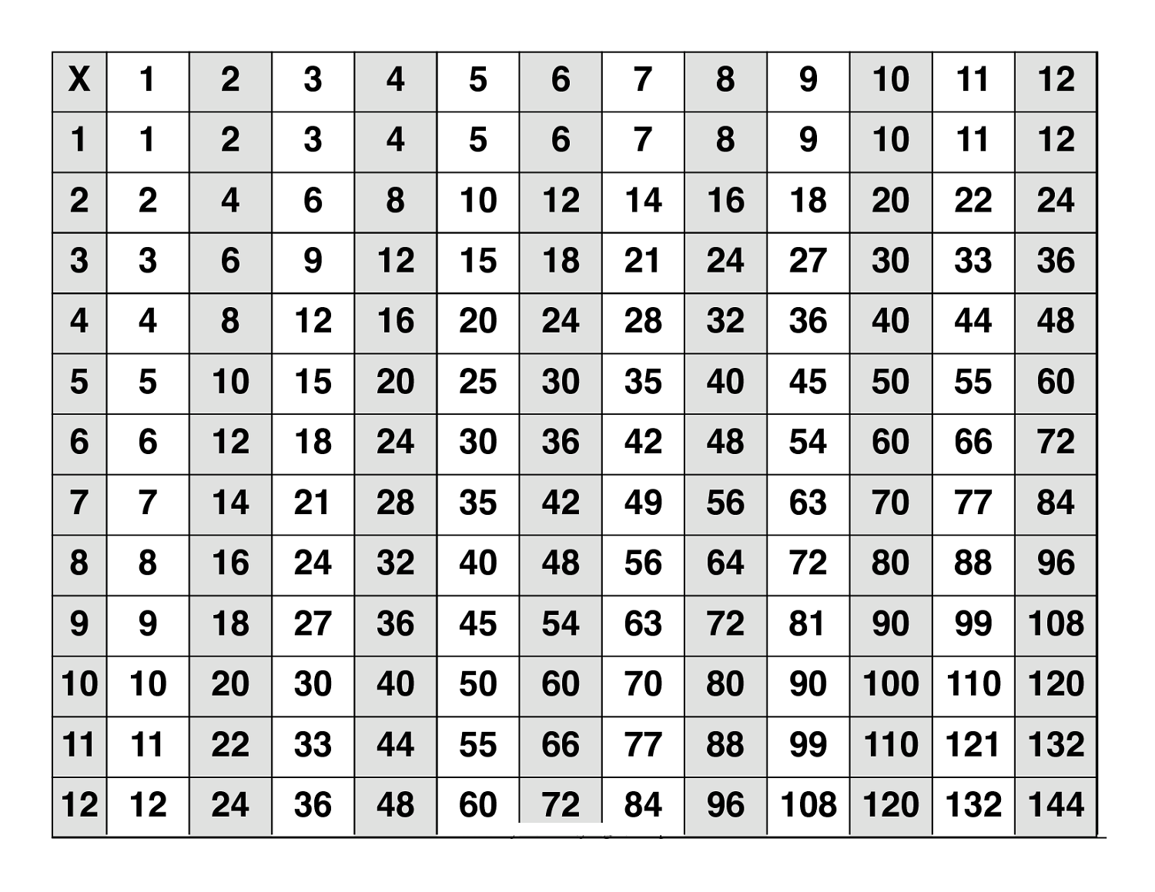
Programming Elements Loops
Exercise 7
Design an algorithm as a flowchart that prints the multiplication table for numbers from 1 to 12.
Notes:
Exercise goal: Introduce nested loops

Slide 63
Programming Elements Loops
start
a = 1
a <= 12
stop
b = 1
Nested loops
b <= 12
print a * b
b = b + 1
a = a + 1
Notes:
Questions to ask students:
What happens to the runtime of this algorithm, i.e. how many steps are there in total if the loops are unraveled?
12 * 12 steps, i.e. O(n^2) runtime

Slide 64
What is an Algorithm?
Describing Algorithms with Flowcharts
Introduction to Programming

Slide 65
Introduction to Programming
Implementing Algorithms as Computer Programs
Computers can be instructed to execute algorithms
Computer programs are implementations of algorithms
Programming languages are the formal languages of computers
e.g. C, Java, Python, R
Computer
INPUT
CPU
OUTPUT
MEMORY

Slide 66
Introduction to Programming
Writing Pseudocode
Programming elements, i.e. variables, conditional statements, and loops, can be represented by nearly all programming languages, albeit with slight differences
Python
Java
R
counter = 0
while counter < 5:
counter = counter + 1
if counter != 3:
print(counter)
int counter = 0;
while(counter < 5) {
counter = counter + 1;
if(counter != 3) {
System.out.println(counter);
}}
counter <- 0
while(counter < 5) {
counter <- counter + 1;
if(counter != 3) {
print(counter)
}}
🡺 Identical output!

Slide 67
Introduction to Programming
Writing Pseudocode
Pseudocode is an informal, human-readable, descriptive language meant to resemble common programming languages in its structure
There is no formal syntax – many variations exist that resemble different programming languages
Notes:
Pseudocode: a list of phrases or sentences that describe the steps to solve a programming problem.

Slide 68
Introduction to Programming
Pseudocode Example
ALGORITHM “Averages”:
SET sum = 0
SET counter = 1
INPUT num
WHILE num != 0:
SET sum = sum + num
SET counter = counter + 1
INPUT num
SET avg = sum / counter
IF avg is even:
PRINT ‘Even average: ’, avg
ELSE:
PRINT ‘Odd average: ’, avg
start
sum = 0
counter = 1
input num
num == 0
YES
avg = sum / counter
NO
is avg even?
sum = sum + num
counter = counter + 1
YES
print ‘Even average: ‘, avg
stop
NO
print ‘Odd average: ‘, avg
input num
Notes:
Algorithm: A user enters numbers until 0 is entered and then the average is calculated. A final conditional is added to show how conditionals work in pseudo code (if/else)

Slide 69
Introduction to Programming
Pseudocode Example
Exercise 8
Design an algorithm to play the ‘Fizz Buzz’ game. The algorithm should count from 1 to 100 and print out the numbers. However, if a number is divisible by 3, the algorithm should print ‘Fizz’ instead of the number. If a number is divisible by 5, it should print ’Buzz’ instead of the number. If a number is divisible by both 3 and 5, the algorithm should print ‘Fizz Buzz’ instead of the number. The output should therefore look as follows:
1, 2, Fizz, 4, Buzz, Fizz, 7, 8, Fizz, Buzz, 11, Fizz, 13, 14, Fizz Buzz, 16
Begin by designing a flowchart for this algorithm and then try to translate it into pseudo code.
Notes:
Exercise goal: Final exercise that has many different possible solutions
🡪 Possibly split into groups here (if there is time) and let each group present their solution

Slide 70
Introduction to Programming
Pseudocode Example
start
num = 1
num > 100
YES
stop
print ‘Fizz Buzz’
NO
num divisible by 3?
YES
num divisible by 5?
print ‘Fizz’
YES
NO
NO
print ‘Buzz’
num divisible by 5?
YES
print num
NO
Notes:
Ask students why this is a “bad” solution:
Duplicated node (‘div by 5’) can be replaced with a single ‘div by 15’ node 🡪 introduce modulo operator if necessary
Printing Fizz Buzz can be seen as a combination of printing Fizz and printing Buzz separately 🡪 string concatenation

Slide 71
Introduction to Programming
Pseudocode Example
ALGORITHM “Fizz Buzz”:
SET num = 1
INPUT num
WHILE num < 100:
IF num divisible by 3:
IF num divisible by 5:
PRINT ‘Fizz Buzz’
ELSE:
PRINT ‘Fizz’
ELSE:
IF num divisible by 5:
PRINT ‘Buzz’
ELSE:
PRINT num
Notes:
(continued solution)

Slide 72
Summary
Algorithms are detailed instructions, written in a formal language, that describe the solution to a problem
Common programming elements of algorithms are:
Variables to easily store, reference, and modify values
Conditional statements to make decisions in the algorithm flow
Loops to repeatedly execute certain steps
Algorithms can be concisely and visually represented as flowcharts
Algorithms can be represented with pseudocode to resemble an implementation as a computer program 🡪 more intuitive to design a flowchart first and then translate it into pseudocode.

Slide 73
Quiz 2
https://bit.ly/jds-ip-q2

Slide 74
Thank You

